Slide 1
UNIT V – Microcontroller
8051 – Introduction, Architecture, Addressing Modes and Instruction Set

Slide 2
INTRODUCTION
Three criteria in Choosing a Microcontroller
meeting the computing needs of the task efficiently and cost effectively
  speed, the amount of ROM and RAM, the number of I/O ports and timers, size, packaging, power consumption
  easy to upgrade
  cost per unit
availability of software development tools
  assemblers, debuggers, C compilers, emulator, simulator, technical support
wide availability and reliable sources of the microcontrollers.

Slide 3
INTRODUCTION
a Harvard architecture (separate instruction/data memories)
single chip microcontroller (µC)
developed by Intel in 1980 for use in embedded systems.
today largely superseded by a vast range of faster and/or functionally enhanced 8051-compatible devices manufactured by more than 20 independent manufacturers

Slide 4
INTRODUCTION
Comparison of the 8051 Family Members
Feature 8051 8052 8031
ROM (program space in bytes) 4K 8K 0K
RAM (bytes) 128 256 128
Timers 2 3 2
I/O pins 32 32 32
Serial port 1 1 1
Interrupt sources 6 8 6

Slide 5
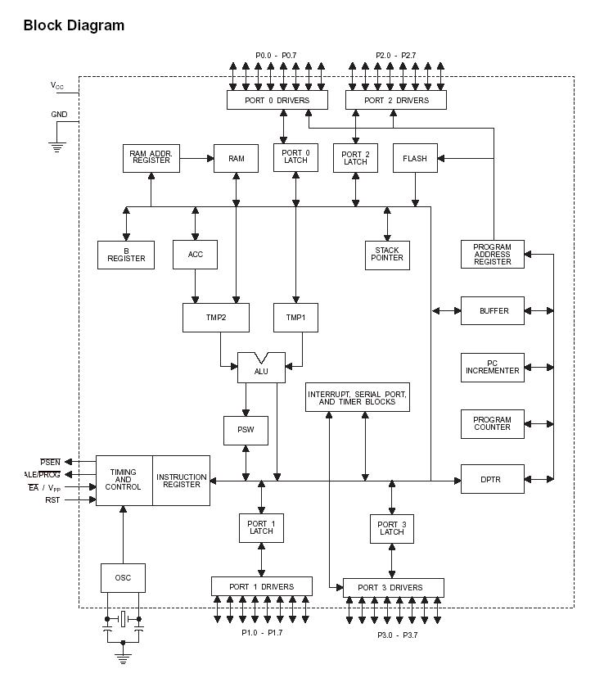

Slide 6
8051 microcontroller features
12 MHz clock. Processor instruction cycle time 1 µs. [in Classic version]
An 8-bit ALU.
Harvard memory architecture – the external program memory and data memory have separate address spaces from 0x0000 and separate control signal(s).
8-bit internal data bus width and 16-bit internal address bus – Harvard memory architecture
CISC (Complex Instruction Set Computer)

Slide 7
8051 microcontroller features (contd.)
Special function registers (SFRs) –PSW (processor status word), A (accumulator), B register, SP (stack pointer) and registers for serial IOs, timers, ports and interrupt handler.
Special bit manipulation instructions.
16-bit Program counter with initial default reset value defined by processor is 0x0000.
8-bit stack pointer with initial default value defined by processor is 0x07

Slide 8
8051 microcontroller features (contd.)
Classic 8051 simple architecture
no floating-point processor,
no cache,
no memory management-unit,
no atomic operations unit,
no pipeline and
no instruction level parallelism

Slide 9
8051 microcontroller features (contd.)
on-chip RAM of 128 bytes. [8052-version RAM 256 bytes.]
32 bytes of RAM also used as four banks (sets) of registers. Each register-set (bank) thus eight registers.
External data/stack memory can be added upto 64 kB in most version. In certain 8051 enhancements, this limit enhanced to 16 MB

Slide 10

PIN DESCRIPTION OF 8051
P1.0
1
40
Vcc
P1.1
2
39
P0.0(AD0)
P1.2
3
38
P0.1(AD1)
P1.3
4
8051
(8031)
37
P0.2(AD2)
P1.4
5
36
P0.3(AD3)
P1.5
6
35
P0.4(AD4)
P1.6
7
34
P0.5(AD5)
P1.7
8
33
P0.6(AD6)
RST
9
32
P0.7(AD7)
(RXD)P3.0
10
31
EA/VPP
(TXD)P3.1
11
30
ALE/PROG
(INT0)P3.2
12
29
PSEN
(INT1)P3.3
13
28
P2.7(A15)
(T0)P3.4
14
27
P2.6(A14)
(T1)P3.5
15
26
P2.5(A13)
(WR)P3.6
16
25
P2.4(A12)
(RD)P3.7
17
24
P2.3(A11)
XTAL2
18
23
P2.2(A10)
XTAL1
19
22
P2.1(A9)
GND
20
21
P2.0(A8)

Slide 11
Pins of 8051
Vcc（pin 40）：
  Vcc provides supply voltage to the chip.
  The voltage source is +5V.
GND（pin 20）：ground
XTAL1 and XTAL2（pins 19,18）：
  These 2 pins provide external clock.
  Way 1：using a quartz crystal oscillator
  Way 2：using a TTL oscillator
  Example 4-1 shows the relationship between XTAL and the machine cycle.

Slide 12
Pins of 8051
RST（pin 9）：reset
  It is an input pin and is active high（normally low）.
    The high pulse must be high at least 2 machine cycles.
  It is a power-on reset.
    Upon applying a high pulse to RST, the microcontroller will reset and all values in registers will be lost.
    Reset values of some 8051 registers
  Way 1：Power-on reset circuit
  Way 2：Power-on reset with debounce

Slide 13
Pins of 8051
/EA（pin 31）：external access
  There is no on-chip ROM in 8031 and 8032 .
  The /EA pin is connected to GND to indicate the code is stored externally.
  /PSEN ＆ ALE are used for external ROM.
  For 8051, /EA pin is connected to Vcc.
  “/” means active low.
/PSEN（pin 29）：program store enable
  This is an output pin and is connected to the OE pin of the ROM.

Slide 14
Pins of 8051
ALE（pin 30）：address latch enable
  It is an output pin and is active high.
  8051 port 0 provides both address and data.
  The ALE pin is used for de-multiplexing the address and data by connecting to the G pin of the 74LS373 latch.
I/O port pins
  The four ports P0, P1, P2, and P3.
  Each port uses 8 pins.
  All I/O pins are bi-directional.

Slide 15
Pins of 8051
Using a quartz crystal oscillator
We can observe the frequency on the XTAL2 pin.
The 8051 has four I/O ports
  Port 0 （pins 32-39）：P0（P0.0～P0.7）
  Port 1（pins 1-8） ：P1（P1.0～P1.7）
  Port 2（pins 21-28）：P2（P2.0～P2.7）
  Port 3（pins 10-17）：P3（P3.0～P3.7）
  Each port has 8 pins.

Slide 16
Pins of 8051
    Named P0.X （X=0,1,...,7）, P1.X, P2.X, P3.X
    Ex：P0.0 is the bit 0（LSB）of P0
    Ex：P0.7 is the bit 7（MSB）of P0
    These 8 bits form a byte.
    Each port can be used as input or output (bi-direction).

Slide 17
8051 INSTRUCTION SET

Slide 18
Data Transfer Instructions
Move byte between accumulator (an SFR) and register at a register bank
Move byte from an SFR/Internal RAM to another direct
Move indirect
Move immediate, MOV immediate DPTR
MOVC and MOVX indirect
Exchange or Push or Pop direct

Slide 19
Bit and Byte Manipulations and Logic instructions
Bit Manipulation
Set, Complement, AND or OR or MOV the bit
Logic Instructions
AND, XOR, OR Operation Instructions
Byte Manipulation
Clear, complement, rotate instructions

Slide 20
Arithmetic Instructions
8-bit Add, Subtract, Multiply and divide Instructions
Increment-Decrement Instructions

Slide 21
Program Flow Control Instructions
Branch instructions
Conditional jumps
Decrement and Jump conditional
Compare and then conditional jump
Subroutine Call Instructions
NOP
Delay

Slide 22
Interrupt Flow Control Instructions
Interrupt flow control- mask bits, priority bits
RETI

Slide 23
Addressing Modes
Addressing modes specifies where the data (operand) is. They specify the source or destination of data (operand) in several different ways, depending upon the situation.
Addressing modes are used to know where the operand located is.

Slide 24
Addressing Modes
There are 5 types of addressing modes:
Register addressing.
Direct addressing.
Register indirect addressing.
Immediate addressing.
Index addressing.

Slide 25
Register Addressing Mode
In register addressing mode; the source and/or destination is a register.
In this case; data is placed in any of the 8 registers(R0-R7); in instructions it is specified with letter Rn (where N indicates 0 to 7).

Slide 26
Register Addressing Mode
For example;
ADD A, Rn (This is general instruction).
ADD A, R5 (This instruction will add the contents of register R5 with the accumulator contents).

Slide 27
Direct Addressing Mode
In direct addressing mode; the address of memory location containing data to be read is specified in instruction.
In this case; address of the data is given with the instruction itself.

Slide 28
Direct Addressing Mode
For example;
MOV A, 25H (This instruction will read/move the data from internal RAM address 25H and store it in the accumulator.

Slide 29
Register Indirect Addressing Mode
In register indirect addressing mode; the contents of the designated register are used as a pointer to memory.
In this case; data is placed in memory, but address of memory location is not given directly with instruction.

Slide 30
Register Indirect Addressing Mode
For example;
MOV A,@R0 This instruction moves the data from the register whose address is in the R0 register into the accumulator.

Slide 31
Immediate Addressing Mode
In immediate addressing mode, the data is given with the instruction itself.
In this case; the data to be stored in memory immediately follows the opcode.

Slide 32
Immediate Addressing Mode
For example;
MOV A, #25H (This instruction will move the data 25H to accumulator.

Slide 33
Index Addressing Mode
Offset (from accumulator) is added to the base index register( DPTR OR Program Counter) to form the effective address of the memory location.
In this case; this mode is made for reading tables in the program memory.

Slide 34
Index Addressing Mode
For example;
MOVC A, @ A + DPTR ( This instruction moves the data from the memory to accumulator; whose address is computed by adding the contents of accumulator and DPTR)

Slide 35
UNIT V – Microcontroller
Timers/Counters – Serial communication – Assembly Language Program – Applications of Microcontroller.
PREPARED BY
GAYATHR.M
ASSISTANT PROFESSOR
DEPARTMENT OF COMPUTER SCIENCE AND ENGINEERING
SRM UNIVERSITY

Slide 36
8051 timer/counter

Slide 37
Timers /Counters Programming
The 8051 has 2 timers/counters: timer/counter 0 and timer/counter 1. They can be used as
The timer is used as a time delay generator.
  The clock source is the internal crystal frequency of the 8051.
An event counter.
  External input from input pin to count the number of events on registers.
  These clock pulses cold represent the number of people passing through an entrance, or the number of wheel rotations, or any other event that can be converted to pulses.

Slide 38
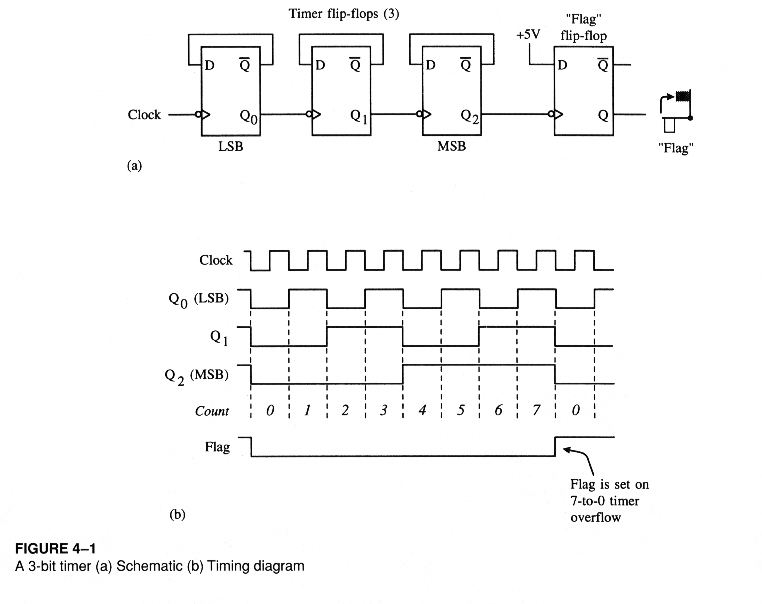

Slide 39
Timer
Set the initial value of registers
Start the timer and then the 8051 counts up.
Input from internal system clock (machine cycle)
When the registers equal to 0 and the 8051 sets a bit to denote time out
8051
P2
P1
to
LCD
Set
Timer 0
TH0
TL0

Slide 40
Counter
Count the number of events
  Show the number of events on registers
  External input from T0 input pin (P3.4) for Counter 0
  External input from T1 input pin (P3.5) for Counter 1
  External input from Tx input pin.
  We use Tx to denote T0 or T1.
8051
TH0
P1
to
LCD
TL0
P3.4
a switch
T0

Slide 41
Registers Used in Timer/Counter
TH0, TL0, TH1, TL1
TMOD (Timer mode register)
TCON (Timer control register)
Since 8052 has 3 timers/counters, the formats of these control registers are different.
  T2CON (Timer 2 control register), TH2 and TL2 used for 8052 only.

Slide 42
Basic Registers of the Timer
Both timer 0 and timer 1 are 16 bits wide.
  These registers stores
    the time delay as a timer
    the number of events as a counter
  Timer 0: TH0 & TL0
    Timer 0 high byte, timer 0 low byte
  Timer 1: TH1 & TL1
    Timer 1 high byte, timer 1 low byte
  Each 16-bit timer can be accessed as two separate registers of low byte and high byte.

Slide 43
Timer Registers
TH0
TL0
D15
D14
D13
D12
D11
D10
D9
D8
D7
D6
D5
D4
D3
D2
D1
D0
Timer 0
TH1
TL1
D15
D14
D13
D12
D11
D10
D9
D8
D7
D6
D5
D4
D3
D2
D1
D0
Timer 1

Slide 44
TMOD Register
Timer mode register: TMOD
  MOV TMOD,#21H
  An 8-bit register
  Set the usage mode for two timers
    Set lower 4 bits for Timer 0 (Set to 0000 if not used)
    Set upper 4 bits for Timer 1 (Set to 0000 if not used)
  Not bit-addressable
(MSB)
(LSB)
GATE
C/T
M1
M0
GATE
C/T
M1
M0
Timer 1
Timer 0

Slide 45
Figure 9-3. TMOD Register
GATE Gating control when set. Timer/counter is enabled only while the INTx pin is high and the TRx control pin is set. When cleared, the timer is enabled whenever the TRx control bit is set.
C/T Timer or counter selected cleared for timer operation (input from internal system clock). Set for counter operation (input from Tx input pin).
M1 Mode bit 1
M0 Mode bit 0
(MSB)
(LSB)
GATE
C/T
M1
M0
GATE
C/T
M1
M0
Timer 1
Timer 0

Slide 46
C/T (Clock/Timer)
This bit is used to decide whether the timer is used as a delay generator or an event counter.
C/T = 0 : timer
C/T = 1 : counter

Slide 47
Gate
Every timer has a mean of starting and stopping.
  GATE=0
    Internal control
    The start and stop of the timer are controlled by way of software.
    Set/clear the TR for start/stop timer.
  GATE=1
    External control
    The hardware way of starting and stopping the timer by software and an external source.
    Timer/counter is enabled only while the INT pin is high and the TR control pin is set (TR).

Slide 48
M1, M0
M0 and M1 select the timer mode for timers 0 & 1.
M1 M0 Mode Operating Mode
0 0 0 13-bit timer mode
8-bit THx + 5-bit TLx (x= 0 or 1)
0 1 1 16-bit timer mode
8-bit THx + 8-bit TLx
1 0 2 8-bit auto reload
8-bit auto reload timer/counter;
THx holds a value which is to be reloaded into
TLx each time it overflows.
1 1 3 Split timer mode

Slide 49
Example 9-3
Find the value for TMOD if we want to program timer 0 in mode 2,
use 8051 XTAL for the clock source, and use instructions to start
and stop the timer.
Solution:
TMOD= 0000 0010 Timer 1 is not used.
Timer 0, mode 2,
C/T = 0 to use XTAL clock source (timer)
gate = 0 to use internal (software)
start and stop method.
timer 1 timer 0

Slide 50
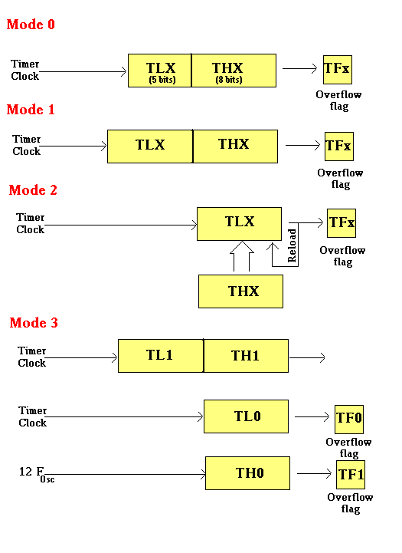
Timer modes

Slide 51
TCON Register (1/2)
Timer control register: TMOD
  Upper nibble for timer/counter, lower nibble for interrupts
TR (run control bit)
  TR0 for Timer/counter 0; TR1 for Timer/counter 1.
  TR is set by programmer to turn timer/counter on/off.
    TR=0: off (stop)
    TR=1: on (start)
(MSB)
(LSB)
TF1
TR1
TF0
TR0
IE1
IT1
IE0
IT0
Timer 1 Timer0
for Interrupt

Slide 52
TCON Register (2/2)
TF (timer flag, control flag)
  TF0 for timer/counter 0; TF1 for timer/counter 1.
  TF is like a carry. Originally, TF=0. When TH-TL roll over to 0000 from FFFFH, the TF is set to 1.
    TF=0 : not reach
    TF=1: reach
    If we enable interrupt, TF=1 will trigger ISR.
(MSB)
(LSB)
TF1
TR1
TF0
TR0
IE1
IT1
IE0
IT0
Timer 1 Timer0
for Interrupt

Slide 53
Equivalent Instructions for the Timer Control Register
For timer 0
 | SETB TR0 | = | SETB TCON.4
 | CLR TR0 | = | CLR TCON.4
 | SETB TF0 | = | SETB TCON.5
 | CLR TF0 | = | CLR TCON.5
For timer 1
 | SETB TR1 | = | SETB TCON.6
 | CLR TR1 | = | CLR TCON.6
 | SETB TF1 | = | SETB TCON.7
 | CLR TF1 | = | CLR TCON.7
TCON: Timer/Counter Control Register
TF1
TR1
TF0
TR0
IE1
IT1
IE0
IT0

Slide 54
Timer Mode 1
In following, we all use timer 0 as an example.
16-bit timer (TH0 and TL0)
TH0-TL0 is incremented continuously when TR0 is set to 1. And the 8051 stops to increment TH0-TL0 when TR0 is cleared.
The timer works with the internal system clock. In other words, the timer counts up each machine cycle.
When the timer (TH0-TL0) reaches its maximum of FFFFH, it rolls over to 0000, and TF0 is raised.
Programmer should check TF0 and stop the timer 0.

Slide 55
Steps of Mode 1 (1/3)
Choose mode 1 timer 0
  MOV TMOD,#01H
Set the original value to TH0 and TL0.
  MOV TH0,#FFH
  MOV TL0,#FCH
You had better to clear the flag to monitor: TF0=0.
  CLR TF0
Start the timer.
  SETB TR0

Slide 56
Steps of Mode 1 (2/3)
The 8051 starts to count up by incrementing the TH0-TL0.
  TH0-TL0= FFFCH,FFFDH,FFFEH,FFFFH,0000H
TR0=1
TR0=0
TH0
TL0
Start timer
Stop timer
FFFC
FFFD
FFFE
FFFF
0000
TF = 0
TF = 0
TF = 0
TF = 0
TF = 1
TF
Monitor TF until TF=1

Slide 57
Steps of Mode 1 (3/3)
When TH0-TL0 rolls over from FFFFH to 0000, the 8051 set TF0=1.
  TH0-TL0= FFFEH, FFFFH, 0000H (Now TF0=1)
Keep monitoring the timer flag (TF) to see if it is raised.
  AGAIN: JNB TF0, AGAIN
Clear TR0 to stop the process.
  CLR TR0
Clear the TF flag for the next round.
  CLR TF0

Slide 58
Mode 1 Programming
XTAL
oscillator
÷ 12
C/T = 0
Timer
overflow flag
TH
TL
TF
TR
TF goes high when FFFF 0

Slide 59
Timer Delay Calculation for XTAL = 11.0592 MHz
(a) in hex
(FFFF – YYXX + 1) × 1.085 μs
where YYXX are TH, TL initial values respectively.
Notice that values YYXX are in hex.
(b) in decimal
Convert YYXX values of the TH, TL register to decimal to get a NNNNN decimal number
then (65536 – NNNNN) × 1.085 μs

Slide 60
Example 9-4 (1/3)
square wave of 50% duty on P1.5
Timer 0 is used
;each loop is a half clock
MOV TMOD,#01 ;Timer 0,mode 1(16-bit)
HERE: MOV TL0,#0F2H ;Timer value = FFF2H
MOV TH0,#0FFH
CPL P1.5
ACALL DELAY
SJMP HERE
P1.5
50%
50%
whole clock

Slide 61
Example 9-4 (2/3)
;generate delay using timer 0
DELAY:
SETB TR0 ;start the timer 0
AGAIN:JNB TF0,AGAIN
CLR TR0 ;stop timer 0
CLR TF0 ;clear timer 0 flag
RET
FFF2
FFF3
FFF4
FFFF
0000
TF0 = 0
TF0 = 0
TF0 = 0
TF0 = 0
TF0 = 1

Slide 62
Example 9-4 (3/3)
Solution:
In the above program notice the following steps.
1. TMOD = 0000 0001 is loaded.
2. FFF2H is loaded into TH0 – TL0.
3. P1.5 is toggled for the high and low portions of the pulse.
4. The DELAY subroutine using the timer is called.
5. In the DELAY subroutine, timer 0 is started by the “SETB TR0”
instruction.
6. Timer 0 counts up with the passing of each clock, which is provided by the crystal oscillator.
As the timer counts up, it goes through the states of FFF3, FFF4, FFF5, FFF6, FFF7, FFF8, FFF9, FFFA, FFFB, FFFC, FFFFD, FFFE, FFFFH. One more clock rolls it to 0, raising the timer flag (TF0 = 1). At that point, the JNB instruction falls through.
7. Timer 0 is stopped by the instruction “CLR TR0”. The DELAY subroutine ends, and the process is repeated.
Notice that to repeat the process, we must reload the TL and TH
registers, and start the timer again (in the main program).

Slide 63
Example 9-9 (1/2)
This program generates a square wave on pin P1.5 Using timer 1
Find the frequency.(dont include the overhead of instruction delay)
XTAL = 11.0592 MHz
MOV TMOD,#10H ;timer 1, mode 1
AGAIN:MOV TL1,#34H ;timer value=3476H
MOV TH1,#76H
SETB TR1 ;start
BACK: JNB TF1,BACK
CLR TR1 ;stop
CPL P1.5 ;next half clock
CLR TF1 ;clear timer flag 1
SJMP AGAIN ;reload timer1

Slide 64
Example 9-9 (2/2)
Solution:
  FFFFH – 7634H + 1 = 89CCH = 35276 clock count
  Half period = 35276 × 1.085 μs = 38.274 ms
  Whole period = 2 × 38.274 ms = 76.548 ms
  Frequency = 1/ 76.548 ms = 13.064 Hz.
Note
Mode 1 is not auto reload then the program must reload the TH1, TL1 register every timer overflow if we want to have a continuous wave.

Slide 65
Find Timer Values
Assume that XTAL = 11.0592 MHz .
And we know desired delay
how to find the values for the TH,TL ?
    Divide the delay by 1.085 μs and get n.
    Perform 65536 –n
    Convert the result of Step 2 to hex (yyxx )
    Set TH = yy and TL = xx.

Slide 66
Example 9-12 (1/2)
Assuming XTAL = 11.0592 MHz,
write a program to generate a square wave of 50 Hz frequency on pin P2.3.
Solution:
The period of the square wave = 1 / 50 Hz = 20 ms.
The high or low portion of the square wave = 10 ms.
10 ms / 1.085 μs = 9216
65536 – 9216 = 56320 in decimal = DC00H in hex.
TL1 = 00H and TH1 = DCH.

Slide 67
Example 9-12 (2/2)
MOV TMOD,#10H ;timer 1, mode 1
AGAIN: MOV TL1,#00 ;Timer value = DC00H
MOV TH1,#0DCH
SETB TR1 ;start
BACK: JNB TF1,BACK
CLR TR1 ;stop
CPL P2.3
CLR TF1 ;clear timer flag 1
SJMP AGAIN ;reload timer since
;mode 1 is not
;auto-reload

Slide 68
Generate a Large Time Delay
The size of the time delay depends on two factors:
  They crystal frequency
  The timer’s 16-bit register, TH & TL
The largest time delay is achieved by making TH=TL=0.
What if that is not enough?
Next Example show how to achieve large time delay

Slide 69
Example 9-13
Examine the following program and find the time delay in seconds.
Exclude the overhead due to the instructions in the loop.
MOV TMOD,#10H
MOV R3,#200
AGAIN: MOV TL1,#08
MOV TH1,#01
SETB TR1
BACK: JNB TF1,BACK
CLR TR1
CLR TF1
DJNZ R3,AGAIN
Solution:
TH – TL = 0108H = 264 in decimal
65536 – 264 = 65272.
One of the timer delay = 65272 × 1.085 μs = 70.820 ms
Total delay = 200 × 70.820 ms = 14.164024 seconds

Slide 70
Timer Mode 0
Mode 0 is exactly like mode 1 except that it is a 13-bit timer instead of 16-bit.
  8-bit TH0
  5-bit TL0
The counter can hold values between 0000 to 1FFF in TH0-TL0.
  2¹³-1= 2000H-1=1FFFH
We set the initial values TH0-TL0 to count up.
When the timer reaches its maximum of 1FFFH, it rolls over to 0000, and TF0 is raised.

Slide 71
Timer Mode 2
8-bit timer.
  It allows only values of 00 to FFH to be loaded into TH0.
Auto-reloading
TL0 is incremented continuously when TR0=1.
next example: 200 MCs delay on timer 0.
See Examples 9-14 to 9-16

Slide 72
Steps of Mode 2 (1/2)
Chose mode 2 timer 0
  MOV TMOD,#02H
Set the original value to TH0.
  MOV TH0,#38H
Clear the flag to TF0=0.
  CLR TF0
After TH0 is loaded with the 8-bit value, the 8051 gives a copy of it to TL0.
  TL0=TH0=38H
Start the timer.
  SETB TR0

Slide 73
Steps of Mode 2 (2/2)
The 8051 starts to count up by incrementing the TL0.
  TL0= 38H, 39H, 3AH,....
When TL0 rolls over from FFH to 00, the 8051 set TF0=1. Also, TL0 is reloaded automatically with the value kept by the TH0.
  TL0= FEH, FFH, 00H (Now TF0=1)
  The 8051 auto reload TL0=TH0=38H.
  Clr TF0
  Go to Step 6 (i.e., TL0 is incrementing continuously).
Note that we must clear TF0 when TL0 rolls over. Thus, we can monitor TF0 in next process.
Clear TR0 to stop the process.
  Clr TR0

Slide 74
Timer 1 Mode 2 with internal Input
XTAL
oscillator
÷ 12
C/T = 0
overflow flag
TL1
TF1
reload
TR1
TH1
TF goes high when FF 0

Slide 75
Example 9-15
Find the frequency of a square wave generated on pin P1.0.
Solution:
MOV TMOD,#2H ;Timer 0,mode 2
MOV TH0,#0
AGAIN:MOV R5,#250 ;count 250 times
ACALL DELAY
CPL P1.0
SJMP AGAIN
DELAY:SETB TR0 ;start
BACK: JNB TF0,BACK ;wait until TL0 ovrflw auto-reload
CLR TR0 ;stop
CLR TF0 ;clear TF
DJNZ R5,DELAY
RET
T = 2 (250 × 256 × 1.085 μs) = 138.88 ms, and frequency = 72 Hz.

Slide 76
Example 9-16
Assuming that we are programming the timers for mode 2, find the
value (in hex) loaded into TH for each of the following cases.
(a) MOV TH1,#-200 (b) MOV TH0,#-60 (c) MOV TH1,#-3
(d) MOV TH1,#-12 (e) MOV TH0,#-48
Solution:
Some 8051 assemblers provide this way.
-200 = -C8H ⇒ 2’s complement of –200 = 100H – C8H = 38 H
Decimal | 2’s complement (TH value)
-200 = - C8H | 38H
- 60 = - 3CH | C4H
- 3 | FDH
- 12 | F4H
- 48 | D0H

Slide 77
Example 9-17 (1/2)
Find
(a) the frequency of the square wave generated in the following code
(b) the duty cycle of this wave.
Solution:
“MOV TH0,#-150” uses 150 clocks.
The DELAY subroutine = 150 × 1.085 μs = 162 μs.
The high portion is twice tat of the low portion (66% duty cycle).
The total period = high portion + low portion
T= 325.5 μs + 162.25 μs = 488.25 μs
Frequency = 2.048 kHz.

Slide 78
Example 9-17 (2/2)
MOV TMOD,#2H ;Timer 0,mode 2
MOV TH0,#-150 ;Count=150
AGAIN:SETB P1.3
ACALL DELAY
ACALL DELAY
CLR P1.3
ACALL DEALY
SJMP AGAIN
DELAY:SETB TR0 ;start
BACK: JNB TF0,BACK
CLR TR0 ;stop
CLR TF0 ;clear TF
RET
high period
low period

Slide 79
Counter
These timers can also be used as counters counting events happening outside the 8051.
When the timer is used as a counter, it is a pulse outside of the 8051 that increments the TH, TL.
When C/T=1, the counter counts up as pulses are fed from
  T0: timer 0 input (Pin 14, P3.4)
  T1: timer 1 input (Pin 15, P3.5)

Slide 80
Port 3 Pins Used For Timers 0 and 1
Pin | Port Pin | Function | Description
14 | P3.4 | T0 | Timer/Counter 0 external input
15 | P3.5 | T1 | Timer/Counter 1 external input
(MSB)
(LSB)
GATE
C/T=1
M1
M0
GATE
C/T=1
M1
M0
Timer 1
Timer 0

Slide 81
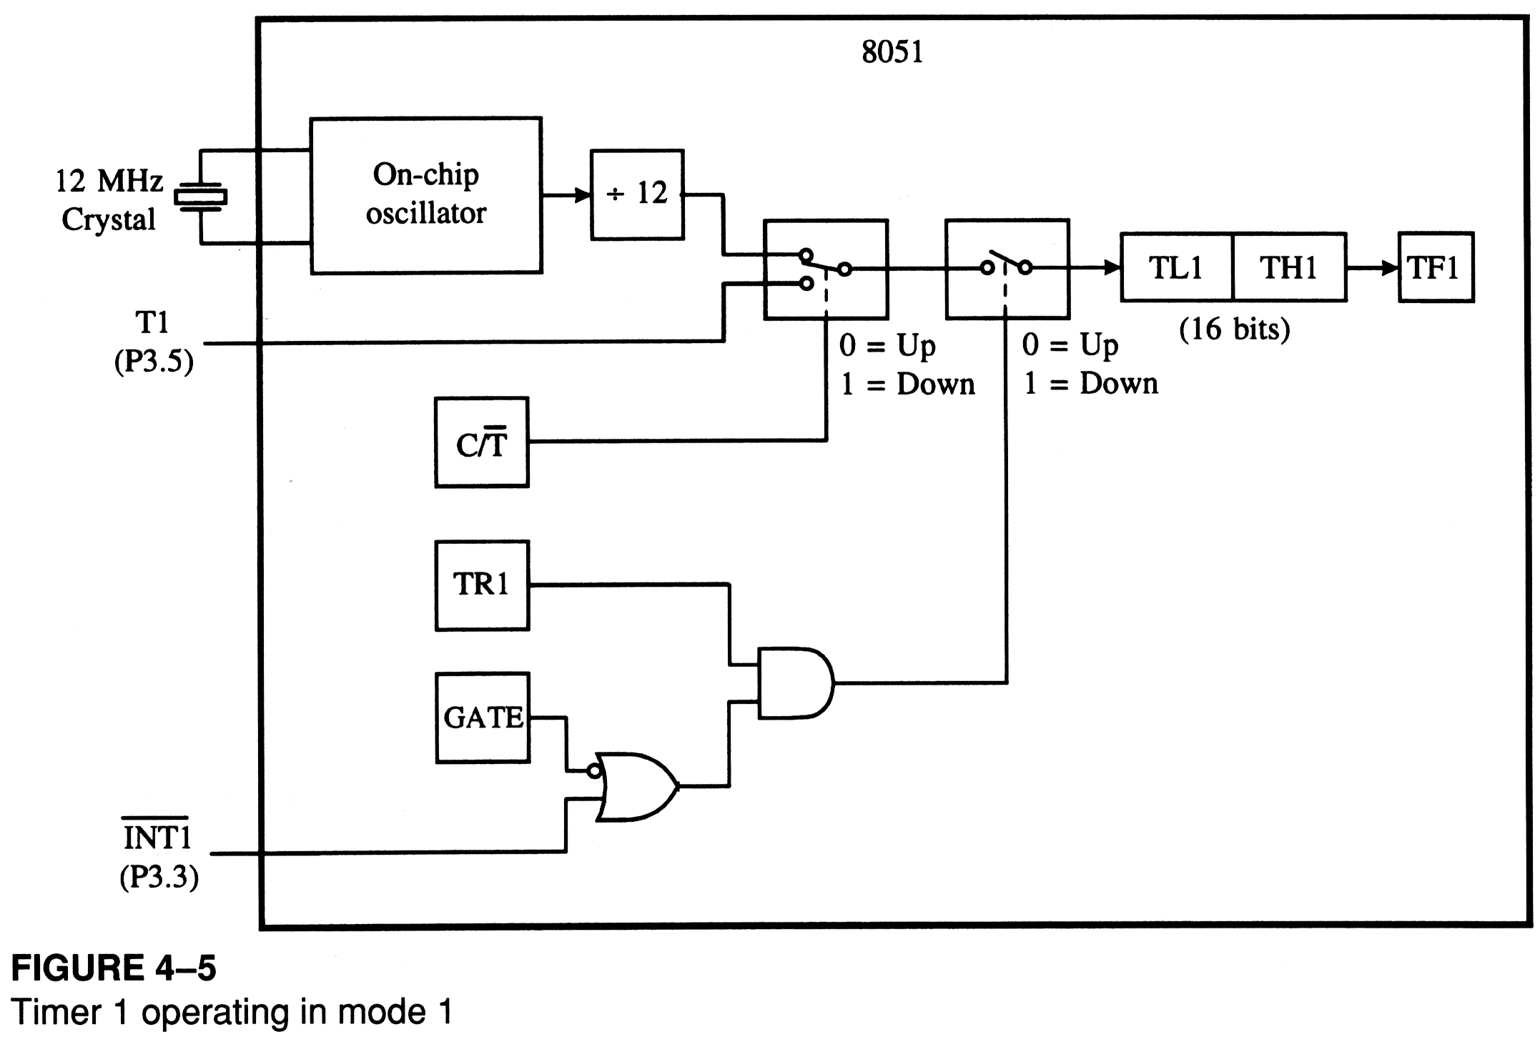
Timer/Counter selection

Slide 82
Counter Mode 1
16-bit counter (TH0 and TL0)
TH0-TL0 is incremented when TR0 is set to 1 and an external pulse (in T0) occurs.
When the counter (TH0-TL0) reaches its maximum of FFFFH, it rolls over to 0000, and TF0 is raised.
Programmers should monitor TF0 continuously and stop the counter 0.
Programmers can set the initial value of TH0-TL0 and let TF0=1 as an indicator to show a special condition. (ex: 100 people have come).

Slide 83

Timer 0 with External Input (Mode 1)
overflow flag
Timer 0 external input Pin 3.4
TH0
TL0
TF0
TF0 goes high when FFFF 0
C/T = 1
TR0

Slide 84
Counter Mode 2
8-bit counter.
  It allows only values of 00 to FFH to be loaded into TH0.
Auto-reloading
TL0 is incremented if TR0=1 and external pulse occurs.
See Figure 9.6, 9.7 for logic view
See Examples 9-18, 9-19

Slide 85
Example 9-18 (1/2)
Assuming that clock pulses are fed into pin T1, write a program for
counter 1 in mode 2 to count the pulses and display the state of the
TL 1 count on P2.
Solution:
MOV TMOD,#01100000B ;mode 2, counter 1
MOV TH1,#0
SETB P3.5 ;make T1 input port
AGAIN:SETB TR1 ;start
BACK: MOV A,TL1
MOV P2,A ;display in P2
JNB TF1,Back ;overflow
CLR TR1 ;stop
CLR TF1 ;make TF=0
SJMP AGAIN ;keep doing it

Slide 86
Example 9-18 (2/2)
Timer 1 as an event counter fed into pin3.5.
“SETB P3.5” make P3.5 an input port by making it high
8051
P2 is connected to 8 LEDs and input T1 to pulse.
P2
to
LEDs
P3.5
T1

Slide 87
Serial Communication
Introduction
Serial communication buses
Asynchronous and synchronous communication
UART block diagram
UART clock requirements
Programming the UARTs
Operation modes
Baud rate calculations—timer 1
Initializing the UART—using timer 1
Baud rate calculations—timer 2
Initializing the UART—using timer 2
UARTx interrupt flags—receiving data
UARTx Interrupt Flags—sending data
Notes:
We start this lecture by looking at the functional block diagram of the UART. We will learn how to program the UARTs and the different modes in which UARTs may be configured. We will learn how to program Timer 1 and Timer 2 to generate the baud rate. The interrupt flags for receiving and sending data will be covered.

Slide 88
Half- and Full-Duplex Transmission
If data can be transmitted and received, it is a duplex transmission
  If data transmitted one way a time, it is referred to as half duplex
  If data can go both ways at a time, it is full duplex
This is contrast to simplex transmission

Slide 89
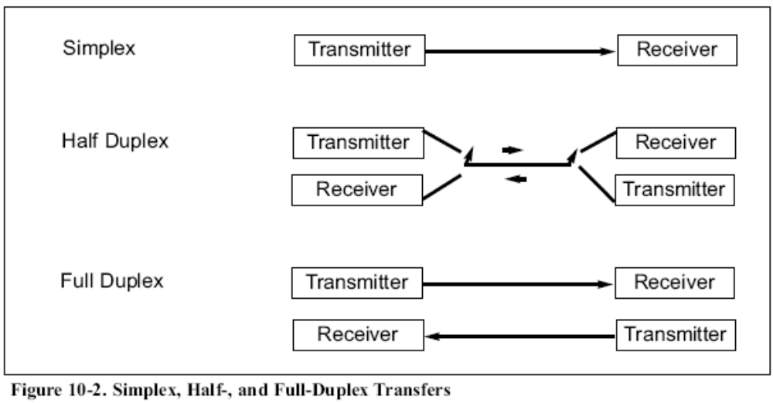

Slide 90
Start and Stop Bits
A protocol is a set of rules agreed by both the sender and receiver on:
  How the data is packed
  How many bits constitute a character
  When the data begins and ends
Asynchronous serial data communication is widely used for character-oriented transmissions
  Each character is placed in between start and stop bits, this is called framing

Slide 91
Start and Stop Bits (cont.)
    The start bit is always one bit
    The stop bit can be one or two bits
    The start bit is always a 0 (low)
    The stop bit(s) is 1 (high)
Block-oriented data transfers use the synchronous method

Slide 92

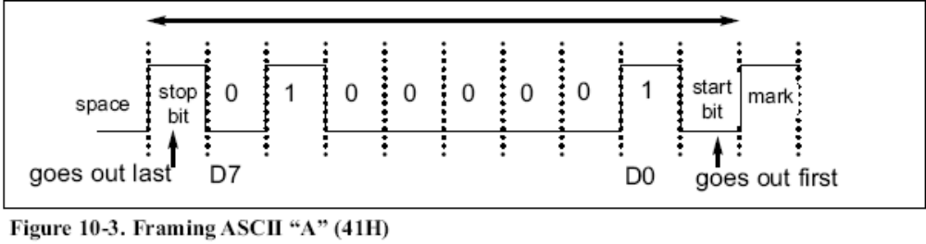
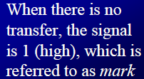

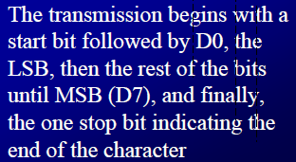

Slide 93
Start and Stop Bits (cont.)
Due to the extended ASCII characters, 8-bit ASCII data is common
  In older systems, ASCII characters were 7-bit
In modern PCs the use of one stop bit is standard
  In older systems, two stop bits were used
    Due to the slowness of the receiving mechanical device
    To give the device sufficient time to organize itself before transmission of the next byte

Slide 94
Start and Stop Bits (cont.)
Assuming that we are transferring a text file of ASCII characters using 1 stop bit
  We have a total of 10 bits for each character
    This gives 20% overhead
In some systems, to maintain data integrity, the parity bit of the character byte is included in the data frame
  UART chips allow programming of the parity bit for odd-, even-, and no-parity options

Slide 95
Data Transfer Rate
The rate of data transfer in serial data communication is stated in bps (bits per second)
Another widely used terminology for bps is baud rate
  It is modem terminology and is defined as the number of signal changes per second
    In modems, there are occasions when a single change of signal transfers several bits of data

Slide 96
Data Transfer Rate (cont.)
  As far as the conductor wire is concerned, the baud rate and bps are the same
The data transfer rate of given computer system depends on communication ports incorporated into that system
  IBM PC/XT could transfer data at the rate of 100 to 9600 bps
  Pentium-based PCs transfer data at rates as high as 56K bps
  In asynchronous serial data communication, the baud rate is limited to 100K bps

Slide 97
RS232 Standards
An interfacing standard RS232 was set by the Electronics Industries Association (EIA) in 1960
  The standard was set long before the advent of the TTL logic family, its input and output voltage levels are not TTL compatible
  A 1 is represented by -3 ~ -25 V
  A 0 bit is +3 ~ +25 V
    Making -3 to +3 undefined

Slide 98
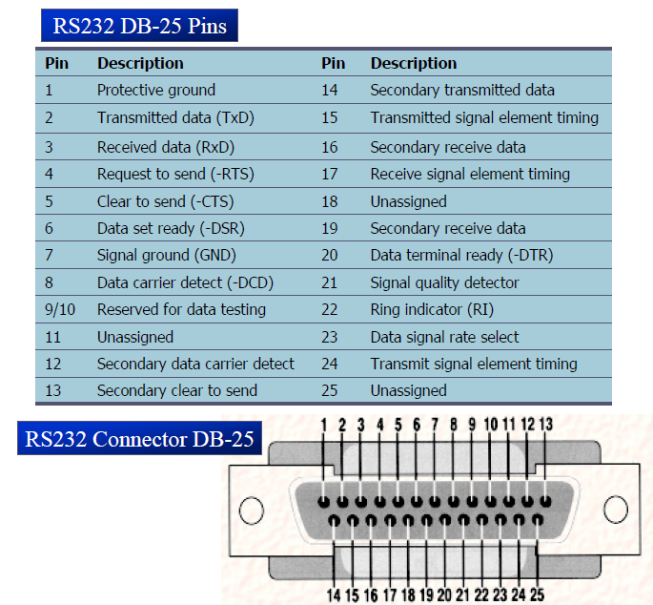

Slide 99
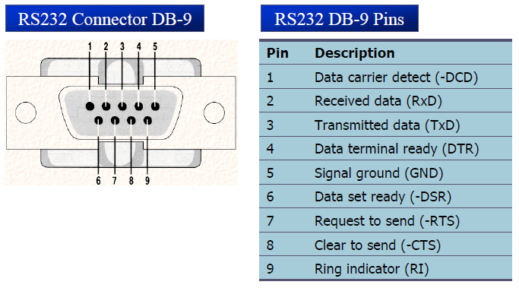
RS232 Standards (cont.)
Since not all pins are used in PC cables, IBM introduced the DB-9 version of the serial I/O standard

Slide 100
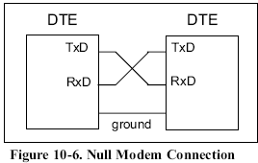
Data Communication Classification
Current terminology classifies data communication equipment as:
  DTE (data terminal equipment)
    Terminal and computers that send and receive data
  DCE (data communication equipment)
    Communication equipment, such as modems
The simplest connection between a PC and microcontroller at least requires:
  Three pins, TxD, RxD, and ground

Slide 101
RS232 Pins
DTR (data terminal ready)
  When terminal is turned on, it sends out signal DTR to indicate that it is ready for communication
DSR (data set ready)
  When DCE is turned on and has gone through the self-test, it assert DSR to indicate that it is ready to communicate

Slide 102
RS232 Pins (cont.)
RTS (request to send)
  When the DTE device has byte to transmit, it asserts RTS to signal the modem that it has a byte of data to transmit
CTS (clear to send)
  When the modem has room for storing the data it is to receive, it sends out signal CTS to DTE to indicate that it can receive the data now

Slide 103
RS232 Pins (cont.)
DCD (data carrier detect)
  The modem asserts signal DCD to inform the DTE that a valid carrier has been detected and that contact between it and the other modem is established
RI (ring indicator)
  An output from the modem and an input to a PC indicates that the telephone is ringing
  It goes on and off in synchronous with the ringing sound

Slide 104
8051 Connection to RS232
A line driver such as the MAX232 chip is required to convert RS232 voltage levels to TTL levels, and vice versa
8051 has two pins that are used specifically for transferring and receiving data serially
  These two pins are called TxD and RxD
    Part of the port 3 group (P3.0 and P3.1)
    These pins are TTL compatible
      They require a line driver to make them RS232 compatible

Slide 105
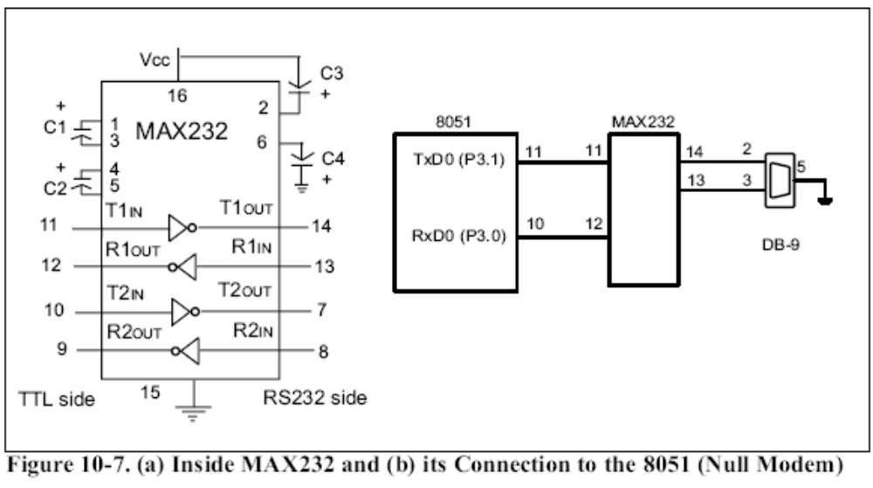

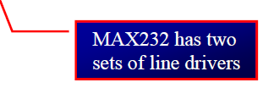

Slide 106
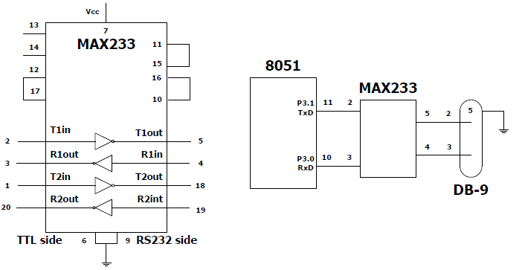
MAX233
To save board space, some designers use MAX233 chip from Maxim
  MAX233 performs the same job as MAX232
    But eliminates the need for capacitors
    MAX233 and MAX232 are not pin compatible

Slide 107
Introduction
Parallel communication implies sending a whole byte (or more) of data over multiple parallel wires
Serial communication implies sending data bit by bit over a single wire
There are 2 types of serial communication:
  Asynchronous
  Synchronous

Slide 108
Serial Communication Buses
Many popular serial communication standards exist—some examples are:
  RS-232 (using UART)
  Serial peripheral interface (SPI)
  System management bus (SMBus)
  Serial ATA (SATA)
The C8051F020 features two UARTs, one SPI, and one SMBus hardware peripherals
We will study and use the UART in this course
UART: Universal asynchronous receiver/transmitter

Slide 109
Asynchronous Serial Communication
With asynchronous communication, the transmitter and receiver do not share a common clock
Add: Start, Stop, Parity Bits
Remove: Start, Stop, Parity Bits
Transmitter
+
–
Receiver
Data
1 byte-wide Data
1 byte-wide Data
The Transmitter
Shifts the parallel data onto the serial line using its own clock
Also adds the start, stop and parity check bits
The Receiver
Extracts the data using its own clock
Converts the serial data back to the parallel form after stripping off the start, stop and parity bits

Slide 110
Asynchronous Serial Communication
Start bit—indicates the beginning of the data word
Stop bit—indicates the end of the data word
Parity bit—added for error detection (optional)
Data bits—the actual data to be transmitted
Baud rate—the bit rate of the serial port
Throughput—actual data transmitted per sec (total bits transmitted—overhead)
  Example: 115200 baud = 115200 bits/sec
  If using 8-bit data, 1 start, 1 stop, and no parity bits, the effective
  throughput is: 115200 * 8 / 10 = 92160 bits/sec
Notes:
Asynchronous transmission is easy to implement but less efficient (i.e. slower) as it requires an extra 2-3 control bits for every 8 data bits.

Slide 111
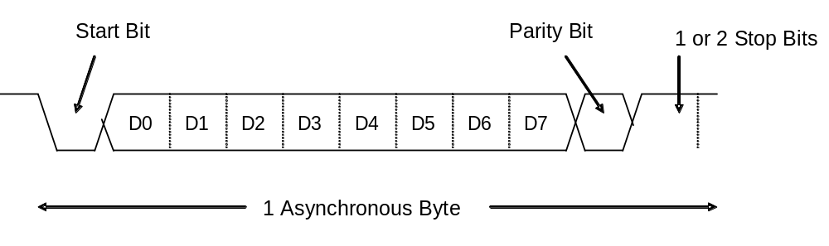
Asynchronous Serial Communication
Asynchronous transmission is easy to implement but less efficient as it requires an extra 2-3 control bits for every 8 data bits
This method is usually used for low volume transmission
Notes:
Asynchronous transmission is easy to implement but less efficient (i.e. slower) as it requires an extra 2-3 control bits for every 8 data bits.

Slide 112
Synchronous Serial Communication
In the synchronous mode, the transmitter and receiver share a common clock
The transmitter typically provides the clock as a separate signal in addition to the serial data
Clock
Transmitter
Receiver
Data
1 byte-wide Data
1 byte-wide Data
The Transmitter
Shifts the data onto the serial line using its own clock
Provides the clock as a separate signal
No start, stop, or parity bits added to data
The Receiver
Extracts the data using the clock provided by the transmitter
Converts the serial data back to the parallel form

Slide 113
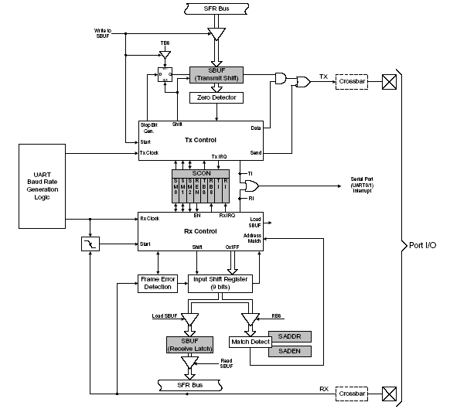
UART Block Diagram
Notes:
This diagram shows the various functional blocks of the UART. UART0 and UART1 are identical in their operation. There are two SFRs - SBUFx and SCONx – used to control and manage the serial communication.

Slide 114
UART Block
Each UART is accessed by two SFRs—SBUFx and SCONx
The Serial Port Buffer (SBUFx) is essentially two buffers: writing loads data to be transmitted to the buffer and reading accesses received data from the buffer.
  These are two separate and distinct buffers (registers): the transmit write-only buffer and the receive read-only register
The Serial Port Control register (SCONx) contains status and control bits
  The control bits set the operating mode for the serial port, and status bits indicate the end of the character transmission or reception
  The status bits are tested in software (polling) or programmed to cause an interrupt
Notes:
Even though the ‘programmer’s model” has only one Serial Port Buffer (SBUFx), there are essentially two separate and distinct hardware buffers (registers) - the transmit write-only buffer and the receive read-only register. Writing to SBUF0 sends the data out serially from the Transmit Shift register through the TX0 pin. The data received on RX0 pin is accumulated in the Receive Latch. A read of SBUF0 fetches the data from the Receive Latch.
The Serial Port Control register (SCONx) contains the status and control bits. The control bits set the operating mode for the serial port, and status bits indicate the end of the character transmission or reception. The status bits are tested in software (polling) or programmed to cause an interrupt.

Slide 115
UART Clock Requirements
A UART needs a clock input for bit timing
UART baud rates are usually much lower than the MCU system clock, so the system clock cannot be directly used as the UART clock
Timers are used to generate the UART baud rate by dividing down the system clock
  Example: MCU system clock—22 MHz; UART baud rate—115200
A bit time accuracy of ±2% or better is required at both the transmitter and receiver ends to be able to communicate without errors
  To meet this accuracy requirement, external crystal oscillators with accuracies of 0.1% or better are typically used in systems that use a UART
Notes:
This slide discusses the need for timers to be used with UARTs. Clock accuracy is important for proper UART communication. With a worst case scenario of tx being +2% and rx being –2%, the difference is 4%. This is still under 5%, which is the actual accuracy specified for UARTs (RS-232 specifically). If baud rates differ more than this, then the received bytes can have bit errors.

Slide 116
Programming the UARTs
The UARTs can be programmed through the following sequence:
Step 1: configure the digital crossbar (XBR0 or XBR2) to enable UART operation
  Set the TXx pin to be push-pull by setting the corresponding PnMDOUT bit (PnMDOUT.n)
  The digital crossbar has to be configured to enable TXx and RXx as external I/O pins (XBR0.2 for UART0 and XBR2.2 for UART1)
  In addition, XBARE (XBR2.6) must be set to 1 to enable the crossbar
Step 2: initialize the appropriate timers for desired baud rate generation
  Timer 1 can be used to generate baud rate for UART0 and UART1
  Timer 2 can be used to generate baud rate for UART0
  Timer 4 can be used to generate baud rate for UART1
Step 3: enable/disable the baud rate doubler SMODx (PCON register)
Step 4: select the serial port operation mode and enable/disable UART reception (SCONx register)
Step 5: enable UART interrupts and set priority (if desired)
Notes:
There are no dedicated pins available for TX and RX. These must be allocated by programming the crossbar. A suitable timer needs to be programmed to generate the baud rate. Program the SCONx register to select the serial port operation mode and enable/disable UART reception. Enable UART interrupts and set priority (if desired).

Slide 117
Operation Modes
The UARTs have four modes of operation, selectable by configuring the SM0x-SM1x bits in SCONx register
Three modes enable asynchronous communications (modes 1 to 3) while the fourth mode (Mode 0) operates as a simple shift register (synchronous)
  8-bit shift register (mode 0)
    Used for port expansion using an external latch
  8-bit UART with variable baud rate (mode 1)
    Most commonly used mode of operation
  9-bit UART with fixed baud rate (mode 2)
    No timer required
    Choose between SYSCLK/32 or SYSCLK/64 for clock
  9-bit UART with variable baud rate (mode 3)
    Used if 9-bit data transmission is required
Notes:
SM0x-SM1x bits in SCONx register used to configure the mode of operation. In this lecture we will discuss only the 8-Bit UART with Variable Baud Rate (Mode 1).

Slide 118
SCONx Register
Bit | Symbol | Description
7-6 | SM0x-SM1x | Serial Port Operation Mode 00: Mode 0: Shift Register Mode 01: Mode 1: 8 Bit UART, Variable Baud Rate 10: Mode 2: 9 Bit UART, Fixed Baud Rate 11: Mode 3: 9 Bit UART, Variable Baud Rate
5 | SM2x | Multiprocessor Communication Enable The function of this bit depends on the Serial Port Operation Mode. Mode 0: No effect. Mode 1: Checks for valid stop bit. 0: Logic level of stop bit is ignored. 1: RIx will only be activated if stop bit is 1 Mode 2 & 3: Multiprocessor Communications Enable. 0: Logic level of 9th bit is ignored. 1: RIx is set and an interrupt is generated only when the 9th bit is 1 and the received address matches the UARTx address or broadcast address.
4 | RENx | Receive Enable 0: UARTx reception disabled 1: UARTx reception enabled
3 | TB8x | 9th Transmission Bit The logic level of this bit will be assigned to the 9th transmission bit in Modes 2 & 3. It is not used in Modes 0 & 1. Set or cleared by software as required.
2 | RB8x | 9th Receive Bit This bit is assigned the logic level of the 9th bit received in Modes 2 & 3. In Mode 1, if SM2x is 0, RB8x is assigned the logic level of the received stop bit. RB8 is not used in Mode 0.
1 | TIx | Transmit Interrupt Flag Set by hardware when a byte of data has been transmitted by UARTx (after the 8th bit in Mode 0, or at the beginning of the stop bits in other modes). When the UARTx interrupt is enabled, setting this bit causes the CPU to vector to the UARTx ISR. This bit must be cleared manually by software.
0 | RIx | Receive Interrupt Flag Set by hardware when a byte of data has been received by UARTx (as selected by the SM2x bit). When the UARTx interrupt is enabled, setting this bit causes the CPU to vector to the UARTx ISR. This bit must be cleared manually by software.
Notes:
The SCONx register is used to select the serial port operation mode and enable/disable UART reception. The mode of operation is configured by programming the SM0x-SM1x bits. For Mode 1 operation, set these bits to 01. TIx and RIx are the Transmit Interrupt Flag and Receive Interrupt Flag respectively.

Slide 119
PCON—Power Control Register
Bit | Symbol | Description
7 | SMOD0 | UART0 Baud Rate Doubler Enable 0: UART0 baud rate divide-by-two enabled. 1: UART0 baud rate divide-by-two disabled.
6 | SSTAT0 | UART0 Enhanced Status Mode Select
5 | Reserved | Read is undefined. Must write 0.
4 | SMOD1 | UART1 Baud Rate Doubler Enable 0: UART1 baud rate divide-by-two enabled. 1: UART1 baud rate divide-by-two disabled.
3 | SSTAT1 | UART1 Enhanced Status Mode Select
2 | Reserved | Read is undefined. Must write 0.
1 | STOP | STOP Mode Select This bit will always read ‘0’. Writing a ‘1’ will place the microcontroller into STOP mode. (Turns off oscillator).
0 | IDLE | IDLE Mode Select This bit will always read ‘0’. Writing a ‘1’ will place the microcontroller into IDLE mode. (Shuts off clock to CPU, but clock to Timers, Interrupts, and all peripherals remain active).
Notes:
The baud rate doubler enable (SMODx) bit is in PCON register.

Slide 120
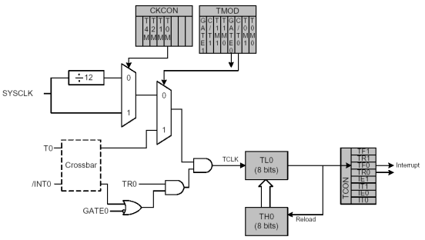
Using Timer 1 to Generate Baud Rate
Timer 1 in mode 2 (8-bit auto-reload mode) can be used to generate the baud rate for UART0 and UART1
Block diagram of Timer 0 in Mode 2 (8-bit Auto-reload mode)
Timer 1 is identical to Timer 0
Notes:
Timer 1 can be used to generate the baudrate for UART0 and UART1 in Mode 2 (8-bit Auto-reload mode).

Slide 121
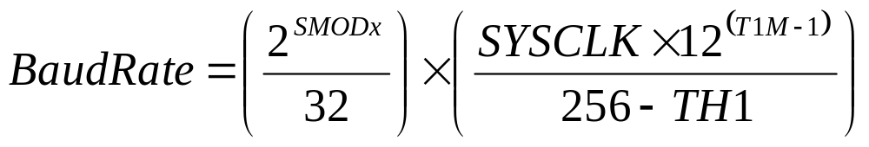
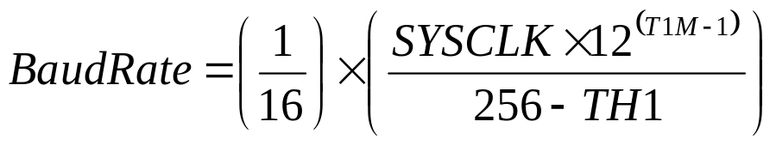
Baud Rate Calculations—Timer 1
The Baud Rate and Timer 1 reload value (for TH1 register) are related by the following equation:
If SMODx=1 (UART Baud Rate divide-by-two disabled)
Notes:
This slide shows the equation used to calculate the reload value of TH1 register when Timer 1 is used to generate the baud rate. The baud rate is dependent on the value of SMODx (Baudrate doubler) bit and T1M (SYSCLK divide-by-two enable/disable) bit.

Slide 122
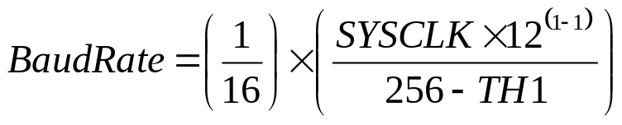
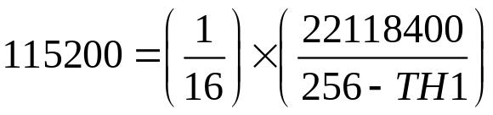
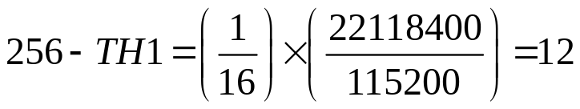


Baud Rate Calculations—Timer 1
If T1M=1 (timer 1 uses the system clock, NOT divided by 12):
If SYSCLK=22.1184 MHz and Baud Rate=115200, then:

Slide 123
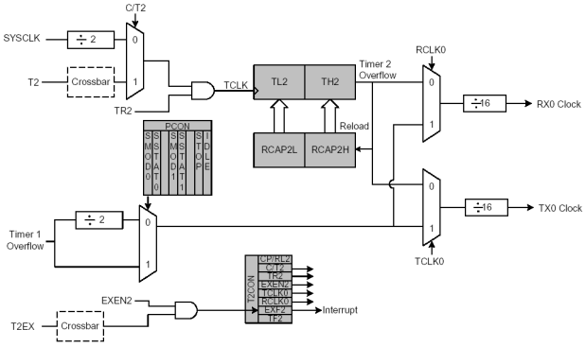
Using Timer 2 to Generate Baud Rate
If timer 2 (or timer 4) is used to generate the baud rate, it must be configured for mode 2 operation (auto-reload mode)
Notes:
To generate the baudrate using Timer 2 (or Timer 4), it must be configured for Mode 2 operation (Auto-Reload Mode).

Slide 124
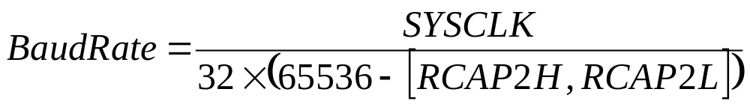
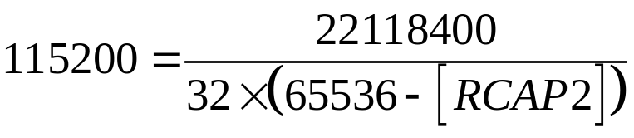
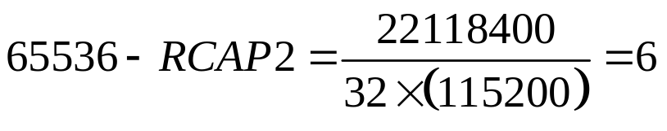

Baud Rate Calculations—Timer 2
The baud rate and timer 2 reload value (for RCAP2 register) are related by the following equation:
If SYSCLK=22.1184 MHz and BaudRate=115200, then:
Notes:
The baud rate is dependent on SYSCLK and RCAP2 (reload value in capture register).

Slide 125
Initializing the UART—Using Timer 2
void Init_UART0_T2(void)
{
//-- Set up Timer 2 to generate the Baudrate (115200) for UART0 ---
CKCON |= 0x20; //-- T2M=1; Timer 2 uses the SYSCLK 22.11845 MHz
T2CON = 0x30; //-- Timer 2 in Mode 2 (Baudrate Generation Mode)
// RCLK0=1 and TCLK0=1
RCAP2 = 0xFFFA; //-- Capture Register value for Baudrate = 115200
TR2 = 1; //-- Start Timer 2 (T2CON.2 = 1)
//-- Set up the UART0 ------------------------------------------
PCON |= 0x80; //-- SMOD0=1 (UART0 BaudRate divide-by-2 disabled)
SCON0 = 0x50; //-- UART0 Mode 1, Logic level of stop bit ignored
// and Receive enabled
//-- Enable UART0 interrupt ------------------------------------
IE |= 0x10;
IP |= 0x10; //-- Set to high priority level
RI0 = 0; //-- Clear the receive interrupt flag;
// ready to receive more
}
Notes:
A code segment to initialise the UART0. Uses Timer 2 to generate the baud rate.
In T2CON register, RCLK0 is set to 1 (i.e. Timer 2 overflows used for receive clock) and TCLK0 is set to 1 (i.e. Timer 2 overflows used for transmit clock).

Slide 126
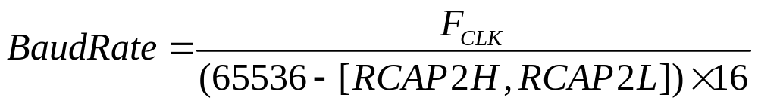
Baud Rate Calculations—Timer 2
If a different time base (other than SYSCLK) is required, setting the C/T2 bit (in T2CON register) to 1 will allow the time base to be derived from the external input pin T2
In this case, the baud rate for the UART is calculated as:
F_{CLK} is the frequency of the signal supplied to timer 2 and [RCAP2H, RCAP2L] is the 16-bit value held in the capture registers
Notes:
A different time base (other than SYSCLK) may be derived from the external input pin T2 to generate the baud rate.

Slide 127
ASSEMBLY LANGUAGE PROGRAMMING & APPLICATIONS OF MICROCONTROLLER
A microcontroller is a versatile chip which can be used in various fields starting from simple consumer electronics to high end medical, automobile and defense applications also. So, now a days the microcontrollers are found in every walk of life. In the lab you can use a microcontroller to measure accurately the voltage, current and resistances also . The various fields are listed below.
Automobile
Aeronautics
Space
Rail Transport
Mobile communications
Industrial processing
Remote sensing , Radio and Networking
Robotics
Consumer electronics , music players, Computer applications
Security (e-commerce, smart cards)
Medical electronics (hospital equipment, and mobile monitoring) and
Defense application

Slide 128
INTERFACING DC MOTOR- 8051
A DC motor runs in response to the applied Direct Current. It produces torque by using both electric and magnetic fields. The DC motor has rotor, stator, field magnet, brushes, shaft, commutator etc.. The DC motor requires large currents, of the order of 400mA for its rotation .But this much amount of current can not be generated by the ports of the microcontroller. So, if you directly connect the DC motor to the ports of the controller ,it may draw high current for its operation from the ports and hence the microcontroller may be damaged. Therefore we use a driving circuit along with an opto isolator .The opto-isolator provides an additional protection to the microcontroller from large currents.
The interface circuit consists of L293D IC which is a dual H-bridge motor driver. This is a 16-pin chip ,which can be used to interface two DC motors and can be controlled in both clockwise and anticlockwise direction of motion.L293 D has an output current of 600mA and peak output current of 1.2A per channel. Also for protection of the circuit from back emf ,output diodes are also included in the IC. The output supply has a wide range from 4.5 V to 36V.
The ILQ74 is A Quad chip with four , optically coupled Gallium Arsenide infrared LED and silicon NPN phototransistor pairs. Signal information, including a DC level, can be transmitted by the device while maintaining a high degree of electrical isolation between input and output.

Slide 129
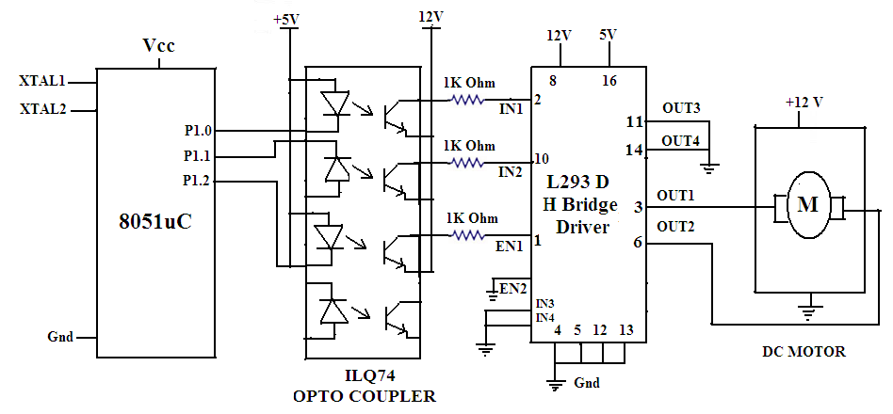

Slide 130
Assembly Language program :
ORG | 0000H |  | Remarks
MAIN | SETB | P1.2 | Enable the H-bridge driver
 | MOV | P1,#00000001B | Motor runs in clockwise
 | ACALL | DELAY
 | MOV | P1,#00000010B | Motor runs in anticlockwise
 | ACALL | DELAY
 | SJMP | MAIN | Motor rotates continuously in clockwise for some time and anticlockwise for some time
DELAY | MOV | R4,#FF H | Load R4 register with FF
 | MOV | R3,#FF H | Load R3 register with FF
LOOP1 | DJNZ | R3,LOOP1 | Decrement R3 until it is zero
LOOP2 | DJNZ | R4,LOOP2 | Decrement R4 until it is zero
 | RET |  | Return to the main program

Slide 131
Stepper motor Interfacing -8051
A stepper motor is a device that translates electrical pulses into mechanical movement in steps of fixed step angle.So, The stepper motor rotates in steps in response to the applied signals. It is used in disk drives, dot matrix printers, plotters and robotics and process control industries.It is mainly used for position control. Stepper motors have a permanent magnet called rotor (also called the shaft) surrounded by a stator . There are also steppers called variable reluctance stepper motors that do not have a PM rotor. The most common stepper motors have four stator windings that are paired with a center-tap. This type of stepper motor is commonly referred to as a. four-phase or unipolar stepper motor. The center tap allows a change of current direction in each of two coils when a winding is grounded, thereby resulting in a polarity change of the stator.

Slide 132
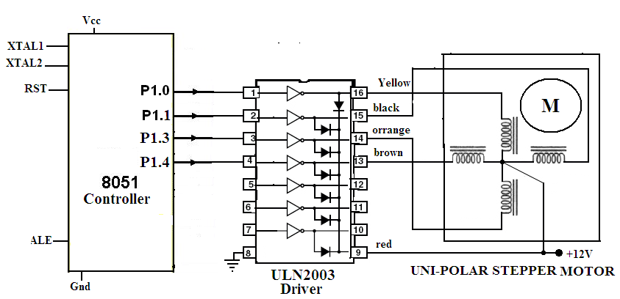

Slide 133
ASSEMBLY LANGUAGE PROGRAM
Main : MOV A,# 0FF H ; Initialisation of Port 1
MOV P1, A ;
MOV A ,#77 H ; Code for the Phase 1
MOV P1 , A ;
ACALL DELAY ; Delay subroutine
MOV A ,# BB H ; Code for the Phase II
MOV P1 , A ;
ACALL DELAY ; Delay subroutine.
MOV A ,# DD H ; Code for the Phase III
MOV P1 , A ;
ACALL DELAY ; Delay subroutine
MOV A ,# EE H ; Code for the Phase 1
MOV P1 , A ;
ACALL DELAY ; Delay subroutine
SJMP MAIN ; Keep the motor rotating continuously.
DELAY Subroutine
MOV R4 ,#0FF H ; Load R4 with FF
MOV R5,# 0FF ; Load R5 with FF
LOOP1: DJNZ R4 ,LOOP1 ; Decrement R4 until zero,wait
LOOP2: DJNZ R5 ,LOOP2 ; Decrement R5 until zero,wait
RET ; Return to main program .

Slide 134
Binary Counter : A binary counter is just like any other counter which counts the numbers in binary form. An 8-bit binary counter counts from 00000000 to 11111111.This binary counter can be realized by interfacing 8-LEDs to the port of the Microcontroller. By sending the continuous pulses through the port, the LEDs are glown continuosly one after the other. The glow of an LED indicates the binary 1 and the No Glow of LED denotes the binary 0.

Slide 135
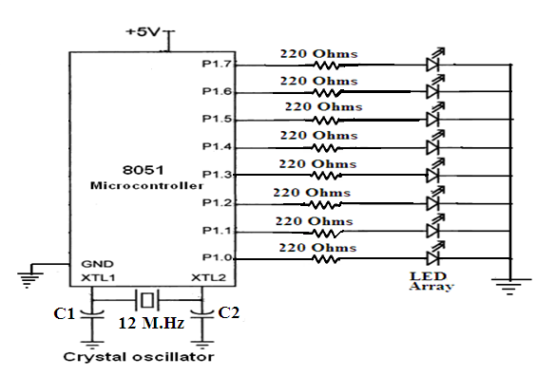

Slide 136
START : MOV A, #00 ; load accumulator with 00
LOOP : MOV P1 , A ; send the contents of accumulator to Port1
CALL DELAY ; Create some delay
INC A ; Increment the content of accumulator.
CJNE A, # 0FF , LOOP ; compare the contents of A with FF and if not equal go to loop.
MOV P1, A ; send the value FF to Port 1
SJMP START ; keep the counter working continuously.
This program counts from 00 to FF and after reaching FF again it starts counting from 00.
Note : The binary counter circuit can also be designed using an inverter buffer IC with port.

Slide 137
Temperature measurement and controlling : The control and measurement of temperature is always an important task.A microcontroller can control and measure the temperature effectively.The temperature sensor LM35 is used to measure the temperature in degree centigrade.LM35 sensor is a precision integrated circuit whose output voltage is linearly proportional to the centigrade temperature.This LM35 do not require any external calibration and it gives 10mV output for 1 degree centigrade.(10mV/⁰C).The LM35 has atypical 1⁰C error over 100⁰C temperature range.

Slide 138
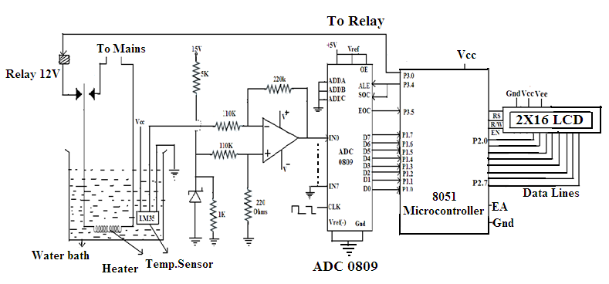

Slide 139
ddress(Hex) | Label | Mnemonics | Operands | Comments
9000 | START | SETB | P3.4 | Send ALE & SOC high
 |  | NOP |  | No operation
 |  | NOP |  | No operation
 |  | CLR | P3.4 | ALE &SOC low
 | LOOP1 | JNB | P3.5 , LOOP1 | Is conversion over ?
 |  | MOV | A,P1 | Read digital data
 |  | CLR | C | Clear carry bit
 |  | SUBB | A,#SET POINT | Compare the measured with Set temp.
 |  | JNC | OFF
 | ON | SETB | P3.0 | Switch on heater
 |  | CALL | CONV | Convert the hex value into Decimal value
 |  | CALL | DISPLAY | Display subroutine to display temp .on LCD
 | OFF | CLRB | P3.0 | Switch off heater
 |  | SJMP | START | Start sensing the temperature
 | DISPLAY | LCALL | 675F
 |  | MOV | R7, #00
 |  | MOV | A, #Set point
 |  | MOV | R6,60H | Display set temp.
 |  | RET |  | Return to main program

Slide 140
MEASUREMENT OF VOLTAGE- 8051 CONTROLLER :
Address(Hex) | Label | Mnemonics | Operands | Comments
9000 | START | SETB | P3.4 | Send ALE & SOC high
 |  | NOP |  | No operation
 |  | NOP |  | No operation
 |  | CLR | P3.4 | ALE &SOC low
 | LOOP1 | JNB | P3.5 , LOOP1 | Is conversion over ?
 |  | MOV | A,P1 | Read digital data(Voltage)
 |  | CALL | CONV | Convert the hex value into Decimal value
 |  | CALL | DISPLAY | Display subroutine to display Voltage on LCD
 |  | SJMP | START | Measure the voltage continuously

Slide 141
MEASUREMENT OF RESISTANCE - 8051 CONTROLLER
Address(Hex) | Label | Mnemonics | Operands | Comments
9000 | START | SETB | P3.4 | Send ALE & SOC high
 |  | NOP |  | No operation
 |  | NOP |  | No operation
 |  | CLR | P3.4 | ALE &SOC low
 | LOOP1 | JNB | P3.5 , LOOP1 | Is conversion over ?
 |  | MOV | A,P1 | Read digital data(Voltage)
 |  | CALL | CONV | Convert the hex value into Decimal value
 |  | MOV | B, # Current value | Load the known value of the current into B register
 |  | DIV | AB | Divide voltage by current
 |  | CALL | DISPLAY | Display subroutine to display resistance value on LCD
 |  | SJMP | START | Measure the resistance continuously

Slide 142
MEASUREMENT OF CURRENT- 8051 CONTROLLER :
Address(Hex) | Label | Mnemonics | Operands | Comments
9000 | START | SETB | P3.4 | Send ALE & SOC high
 |  | NOP |  | No operation
 |  | NOP |  | No operation
 |  | CLR | P3.4 | ALE &SOC low
 | LOOP1 | JNB | P3.5 , LOOP1 | Is conversion over ?
 |  | MOV | A,P1 | Read digital data(Voltage)
 |  | CALL | CONV | Convert the hex value into Decimal value
 |  | MOV | B, # Resistor Value | Load the resistor value into B register
 |  | DIV | AB | Divide voltage by resistance
 |  | CALL | DISPLAY | Display subroutine to display current on LCD
 |  | SJMP | START | Measure the current continuously

Slide 143
THANK YOU

